Slide 1
Computer Vision
Spring 2018
Problem Set #4
Sergiy Palguyev
Sergiy.palguyev@gatech.edu
Computer Vision @ GT

Slide 2
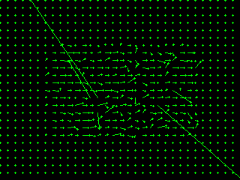

1a: Base Shift0 and ShiftR2
ps4-1-a-1.png
Computer Vision @ GT

Slide 3
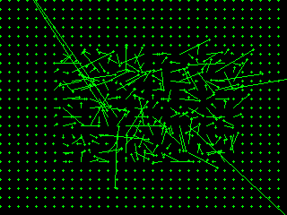
1a: Base Shift0 and ShiftR5U5
ps4-1-a-2.png
Computer Vision @ GT

Slide 4
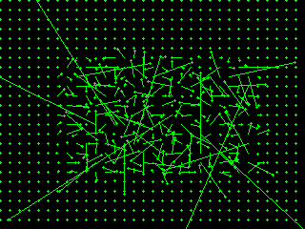
1b: Base Shift0 and ShiftR10
ps4-1-b-1.png
Computer Vision @ GT

Slide 5
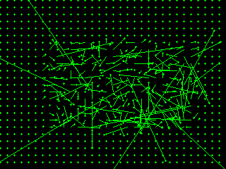
1b: Base Shift0 and ShiftR20
ps4-1-b-2.png
Computer Vision @ GT

Slide 6
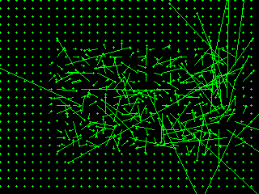
1b: Base Shift0 and ShiftR40
ps4-1-b-3.png
Computer Vision @ GT

Slide 7
1b: Text Response
LK still works but the parameters must be tuned. More specifically, the size of averaging kernel must be tuned in addition to modyfing the filterig type as well.
Computer Vision @ GT

Slide 8
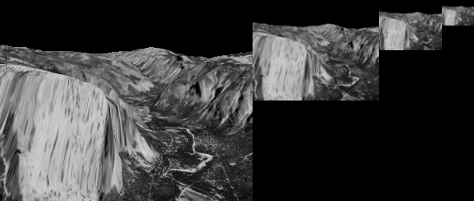

2a: Gaussian Pyramid
ps4-2-a-1.png
Computer Vision @ GT

Slide 9
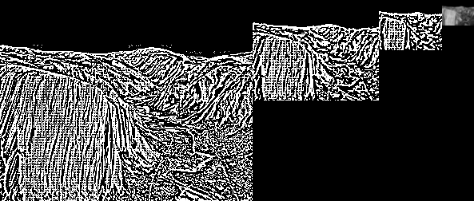
2b: Laplacian Pyramid
Laplacian Pyramid Image - ps4-2-b-1.png
Computer Vision @ GT

Slide 10
3a: Difference images
ps4-3-a-1.png
Computer Vision @ GT

Slide 11
3a: Difference images (cont.)
ps4-3-a-2.png
Computer Vision @ GT

Slide 12
4a: Hierarchical LK
ps4-4-a-1.png
Computer Vision @ GT

Slide 13
4a: Hierarchical LK (cont.)
ps4-4-a-2.png
Computer Vision @ GT

Slide 14
4a: Hierarchical LK (cont.)
ps4-4-a-3.png
Computer Vision @ GT

Slide 15
4b: Hierarchical LK (cont.)
ps4-4-b-1.png
Computer Vision @ GT

Slide 16
4b: Hierarchical LK (cont.)
ps4-4-b-2.png
Computer Vision @ GT

Slide 17
5a: Frame Interpolation
ps4-5-a-1.png
Computer Vision @ GT

Slide 18
5b: Frame Interpolation
ps4-5-b-1.png
Computer Vision @ GT

Slide 19
5b: Frame Interpolation
ps4-5-b-2.png
Computer Vision @ GT

Slide 20
6: Challenge Problem
ps4-6-a-1.png
Computer Vision @ GT

Slide 21
6: Challenge Problem (cont.)
ps4-6-a-2.png
Computer Vision @ GT

Slide 22
6: Challenge Problem (cont.)
Video Link
Computer Vision @ GT

Slide 23
If your pdf is larger than 7MB
Please compress it using (or something similar):
https://smallpdf.com/compress-pdf
Verify that all images are still visible for grading.

